Slide 1
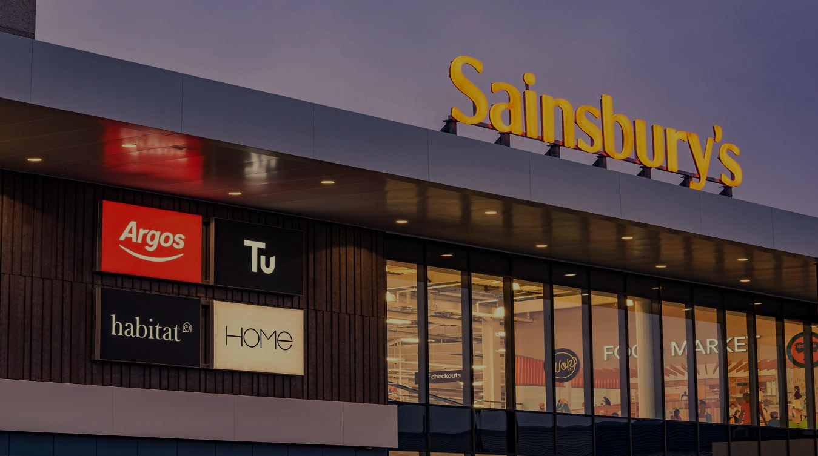



1535+
TCS Team Size
Established in 1869 by John James Sainsbury’s
£29.05 Billion
FY 22 Revenue
2nd Largest coalition
loyalty program in UK
189,000
Employees
1471
Number of Stores
2nd Largest UK Supermarket
16% market Share

Slide 2
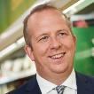















Sainsbury’s Organisation Structure
Simon Roberts
Chief Executive Officer
Angie Risley
Group HR Director
Clodagh Moriarty
Retail and Digital
Director
Graham Biggart
Chief Transformation
Officer
Jim Brown
CEO - Bank
Kevin O’Byrne
Chief Financial Officer
Mark Given
Chief Marketing Officer
Paula Nickolds
GM & Clothing
Commercial Director
Phil Jordan
Chief Information Officer
Rebecca Reilly
Director of Corporate
Affairs
Rhian Bartlett
Food Commercial
Director
Helen Hunter
CTO-Customer & Data
John Elliott
CTO-Colleague &
Operations
Martin Taylor
CTO-Platform Engineering
& Service
Antony Cromb
Head of Business
Transformation
Andrew Nagalewski
Head of Supplier
Management
Relationship Status
Growing
V Good
Good
Neutral

Slide 3
Sainsbury's Financial historical milestones
1936
Expansion into the Midlands, with the acquisition of the Thorough goods chain
2015
Launched grocery Click & Collect service in stores
2018
Acquired Nectar for £60M
1869
First Sainsbury's store opened in London Drury Lane
1977
Sainsbury’s Bank launched
2014
Purchased 50% share in Sainsbury's Bank from Lloyds Banking Group
2016
Completed purchase of Home Retail Group for £1.4B (Argos & Habitat)
2022
Tu Clothing becomes £1B brand
1922
Incorporation of firm as J Sainsbury Ltd
2004
Launched Tu fashion range in 160 stores
2015
281 pharmacies sold to Lloyds Pharmacies
2017
Trialed UK’s first 30-minute Click & Collect grocery service
1973
Public flotation on the stock exchange
2007
Take over bid by Qatari abandoned
2018
Planned merger with ASDA blocked by CMA
Additional :
Nationwide expansion only during 1970-1999 expanding to North, Wales, NI & Scotland
UK’s largest retailer of groceries until 1995 (lost this position to Tesco)
Unveiled new corporate identity in 1999 – Living orange, new logo
Founding member or Nectar Loyalty scheme launched in 2002
With acquisition of Home Retailer Group, Sainsbury’s became a Multi-channel retailer
Corporate Sustainability:
First Supermarket to offer Organic food in 1986
First retailer to introduce Traffic light nutritional labelling on products
Founding partner of Fare Share community food donation programme
First Paralympics sponsor
Principal Supermarket Partner of COP26, the United Nations Climate Change Conference
Notes:
Small circles

Slide 4
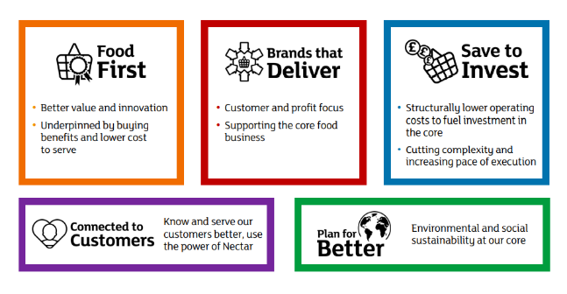
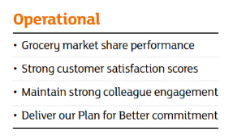
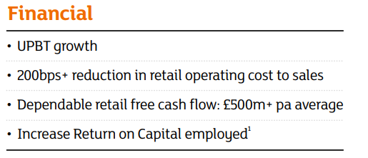
Sainsbury’s - Strategic Priorities & Business Performance
Sainsbury’s Strategic Priorities
Key Metrics
Performance
Grocery sales up year-on-year reflecting tailwinds from
sustained in-home consumption and investments made in the food offers
Market share gains
Underlying profit before tax up 23% year-on-year, and up 56% on a two-year basis
Good underlying free cash flow generation
Free cash flow and net debt reduction targets on track
Strong cost savings progress, particularly at Argos

Slide 5




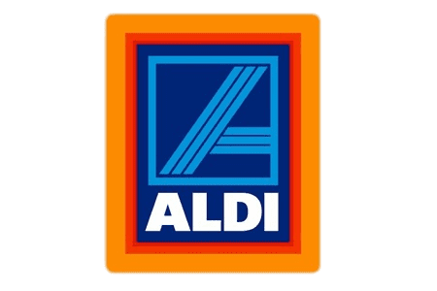



Industry Performance (FY21)
*
*
*
Key Opportunity Areas
Revenue (Mn Pounds)
No. of stores
Gross Margin (%)
Inventory Turnover
Asset Turnover
Employees
Cost of Sale (%)
Sales/Employee
SG&A (%)
Operating Margin (%)
Like for Like Sales(%)
Online sales growth (%)
29048.0
74829.3
22645.4
14716.1
17354.1
455339.4
109621.0
33016.9
1815
3801
497
2775
960
10140
2742
3749
Reduce Cost of Operations
7.49%
6.85%
2.20%
1.70%
3.94%
25.10%
22.01%
29.32%
23.1
28
21.6
24.9
29.5
8.46
15.53
10.41
Drive SG & A
Savings
1.3
1.3
1.6
1.3
2.4
2.3
2.82
1.43
148700
367321
118047
62786
41707
2300000
465000
210067
93.92%
93.15%
97.8%
98.30%
96.06%
74.90%
77.99%
70.68%
Improve Asset Turnover
216.6
216.6
203.72
191.83
234.39
416.10
197.97
235.74
157.17
6.1%
6.1%
3.1%
1.6%
-
1.8%
21.0%
17.0%
6.79%
Improve Inventory Turnover
2.6%
2.6%
3.0%
1.5%
1.80%
-
4.53%
2.52%
5.10%
8.6%
8.6%
6.3%
8.6%
6.9
-
2.3%
-
4.20%
119.6%
-
-
-
-
-
-
-
*US , Australia, Different Cost Structures as compared to UK, Europe

Slide 6
Outside-in Perspective
Area | Area | Tesco | Sainsbury’s | Asda | Morrison’s | Aldi | Lidl | Co-Op | Waitrose | M&S | Iceland
MARKET SHARE |  | 27.3% | 15.0% | 14.1% | 9.5% | 8.8% | 6.6% | 6.0% | 4.8% | 3.6% | 2.2%
UK STORES IGD Datacentre | Hypermarket >60k sqft | 247 stores | 64 stores | 32 stores | - | - | - | - | 8 stores | 217 stores Within department stores | -
 | Supermarket 3k – 60k sqft | 662 stores | 534 stores | 551 stores | 505 stores | 1,086 stores | 950 stores | 588 stores +248 franchise | 252 stores | 345 stores Standalone foodstore | 1,043 stores
 | Convenience & Forecourt <3k sqft | 1,871 stores Excl One Stop/ Franchise | 812 stores | 100 stores | - | - | - | 2,087 stores +844 franchise | 59 stores | 458 stores franchise | -
 | Other | 194 Booker 694 One Stop 210 One Stop Franchise | 637 Argos/ GM | 33 Asda Living | - | - | - | 10 Nisa Wholesale | 43 John Lewis | 32 standalone M&S (Non-Food) | 162 Food Warehouse
ONLINE | Next day+ | ✔ | ✔ | ✔ | ✔ | GM only | - | - | ✔ | Ocado | ✔
 | Click & collect | ✔ | ✔ | ✔ | ✔ | ✔ | - | - | ✔ | ✔ | ✔
 | Rapid delivery | Whoosh, Gorillas & Uber Eats | Chop Chop, Deliveroo & Uber Eats | Just Eat & Uber Eats | Deliveroo & Uber Eats | Deliveroo | - | Deliveroo & Uber Eats | Deliveroo | Deliveroo | Uber Eats
PRESENCE | UK & I | UK wide | UK wide Mostly south | UK wide Mostly north | UK wide Mostly north | UK wide | UK wide Mostly south | UK wide | Mostly south | UK wide Mostly south | UK wide
 | International | Central Europe | - | - | - | US, Europe, Australia (Aldi sud & nord) | US & Europe | UK (although alternative Coop brands exist in Europe) | Hong Kong, New Zealand, Ghana, Bermuda, South Korea | CZE, Franchise in 57 Markets | 53 franchise stores in 9 countries (Europe)
Notes:
One stop delivers rapid groceries through Just Eat

Slide 7
TCS Sainsbury’s Relationship and Org structure

Slide 8
TCS Structure – Business Units
Relationship Incubation Group (RIG): The RIG unit is designed to provide high-touch customer engagements backed by deep capabilities and delivery excellence to incubate new strategic accounts. Comprises of the accounts with annual revenue of less than USD 5 million. Susheel Vasudevan leads Relationship Incubation Group.
Enterprise Growth Group (EGG): Enterprise Growth Group is an integrated operating unit which seamlessly combines vertical units and technology practices into a cohesive collaborative structure. Comprises of the accounts with annual revenue of between USD 5 million and 100 million. Krishnan Ramanujan to lead the Enterprise Growth Group.
Business Transformation Group (BTG): Led by Debashis Ghosh, BTG is a focused group which is dedicated to increase the vibrancy and relevance of TCS in top accounts with dedicated investments and top talent to become their partner in long-term transformation. This group aims to realise the customers’ transformation vision and will be a key vehicle to scale in market penetration in existing clients. Comprises of 29 marquee accounts with annual revenue more than USD 100 million.
Which of the above business units does Sainsbury’s account belong to?
IS-BTG-eCommerce & Algo Retail 2-Parent – 3 accounts (M&S, H&M and Sainsbury’s) headed by Abhijit Niyogi
IS-BTG-eComm & AR -Sainsbury 2.3 (Headed by Sarvottam – Managing Partner at onsite and Muthukumaran Babu at offshore)

Slide 9







TCS Sainsbury’s Relationship Journey
Cloud
Transformation
(Hosting as a service)
SONAR
Infra as a Service
Prime Vendor - Managed Services
Application & Infrastructure Sainsbury's brand
Strategic Partner - Transformation programs
(Retail, HR, Finance & Cloud)
Arthur*
AMS Descope
End to End Project Delivery
2007
2014
2016
2018
2020
FY 2007 - 08
FY 2011 - 12
FY 2013 -14
FY 2014 - 15
FY 2015 - 16
FY 2018 - 19
FY 2019 -20
FY 2020 -21
FY 2021-22
FY 2022 -23
2011
2015
2019
2022
Argos and Nectar Acquisition completed
Staff Aug’ Engagements
Strategic Programs Ownership
Real Time Supply Chain
Agile & DevOps Adoption
Group Technology Partner
Infrastructure and Nectar
Bangalore Chennai Trivandrum London Coventry
Service Ops Modern Engineering Consulting Architecture
Development
TCS emerged as a winner of Best Supplier award twice in last 4 years

Slide 10
Colleague & Operations Domain Structure
Arun AV – Head of Offshore Development
Sachin Goel
Offshore Delivery Partner
Colleague & Operations
Uday Menon
Client Partner
Colleague & Operations
John Elliott
CTO
Colleague & Operations
Ranjit N
Engineering Partner
Supply Chain & Logistics
Karen Brown
Head of Engineering
Supply Chain
Sheethal Bhandary
Offshore Delivery Manager
Supply Chain
Sheethal Bhandary
Offshore Delivery Manager
Logistics
Sakthivel
Delivery Manager
Logistics
Vijay Balan
Delivery Manager
Supply Chain
Colin Smith
Head of Engineering
Logistics
Malar Velu
Engineering Partner
Commercial,
Sathyan S
Offshore Delivery Manager
Commercial
Vijay NS
Offshore Delivery Manager
Finance
Chris Bernans
Head of Engineering
Commercial, Finance & I.F
Pankaj Pathak
Engineering Partner, Finance
Jitendra Pradhan
Delivery Manager
Commercial
Malar Velu
Engineering Partner
Retail, LM, HR & Property
Yagneshwaran R
Offshore Delivery Manager
Retail, LM, HR & Property
Jodie Addison
Head of Engineering
Retail, LM, HR & Property
Srinvas Thota
Delivery Manager
Retail, LM, HR & Property
OFFSHORE
ONSITE

Slide 11
Customer & Data Domain Structure
Arun AV – Head of Offshore Development
Anjans S
Offshore Delivery Partner
Customer & Data
Uday Menon
Client Partner
Customer & Data
Helen Hunter
CTO
Customer & Data
Geofff Knight
Head of Engineering
Discover, Decide & Customer Contact
Visweswara Rao
Offshore Delivery Manager
Discover, Decide & Customer Contact, Buy, Fulfil & Instore
Saurav Dutta
Engineering Partner
Discover, Decide & Customer Contact, Buy, Fulfil & Instore
Bleddyn Williams
Head of Engineering
Buy, Fulfil & Instore
Santosh Shetty
Offshore Delivery Manager
Nectar, Media, Agency, Customer Decisioning, Data & Analytics
Nischal Nakarja
Engineering Partner
Nectar, Media, Agency, Customer Decisioning, Data & Analytics
Chaminga Chandratilake
Head of Engineering
Data
Daniel Mintz
Head of Engineering
Nectar, Media, Agency & Customer Decisioning
OFFSHORE
ONSITE

Slide 12





TCS Sainsburys – Logistics Journey
Legacy Modernization Program
Morden services for legacy Integrations and Interfaces
Integrated Transport Planning
Transport Planning Optimization using Ortec’s Solution
Colleague Coaching App
Standardized approach to coaching across the group
Logistics Platform – Stock Service
Real Time Data for Stock Balance
Logistics Platform – Delivery Service
(DC Consolidation + Networks + Workplace Modernization)
Integrated Depot (IGD)
Single Stock Pool for Group Business
2019
2020
2021
2022
2023
Q1 - Q2
Q3 - Q4
Q1 - Q2
Q3 - Q4
Q1 - Q2
Q3 - Q4
Q1 - Q2
Q3 -- Q4
Q1 - Q2
Q3 - Q4
Logistics Platform – Stock Service
Real Time Data for Stock Receipts
Logmis Replacement
Single Stock Pool for Group Business
Local Fulfilment Centre
Locations to Manage Small Stock Pool for Fast Track Delivery
Transhipment
Consolidate JS & Argos trips into single trip
Colleague Performance Management
Evaluate and Report Performance of Depot Colleagues
Barrier Control System
Control Depot entry for the vehicles involved in trips
Store Delivery Hub
(Retail, HR, Finance & Cloud)

Slide 13
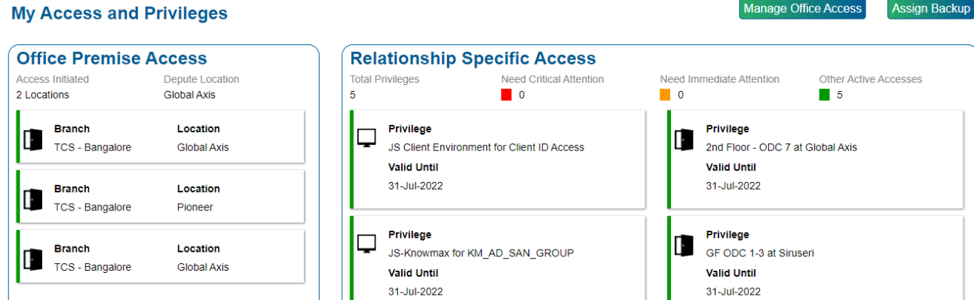
Check your Access
Employee Services -> My Access & Privileges -> Manage Office Access

